Slide 1
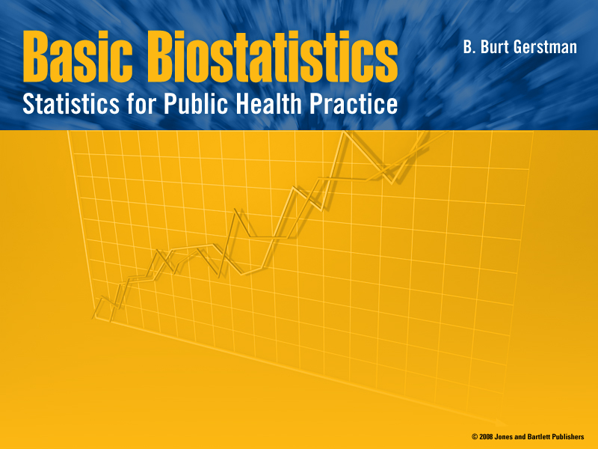
Chapter 15:
Multiple Linear Regression

Slide 2

In Chapter 15:
15.1 The General Idea
15.2 The Multiple Regression Model
15.3 Categorical Explanatory Variables
15.4 Regression Coefficients
[15.5 ANOVA for Multiple Linear Regression]
[15.6 Examining Conditions]
[Not covered in recorded presentation]

Slide 3
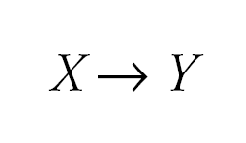
15.1 The General Idea
Simple regression considers the relation between a single explanatory variable and response variable

Slide 4
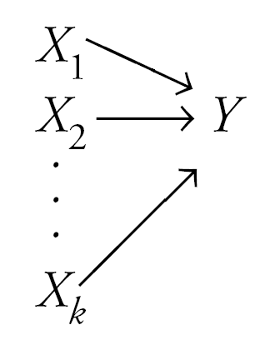
The General Idea
Multiple regression simultaneously considers the influence of multiple explanatory variables on a response variable Y
The intent is to look at the independent effect of each variable while “adjusting out” the influence of potential confounders

Slide 5
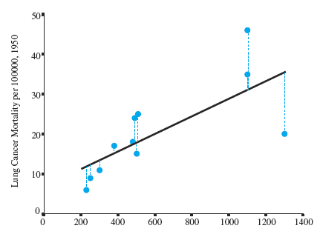
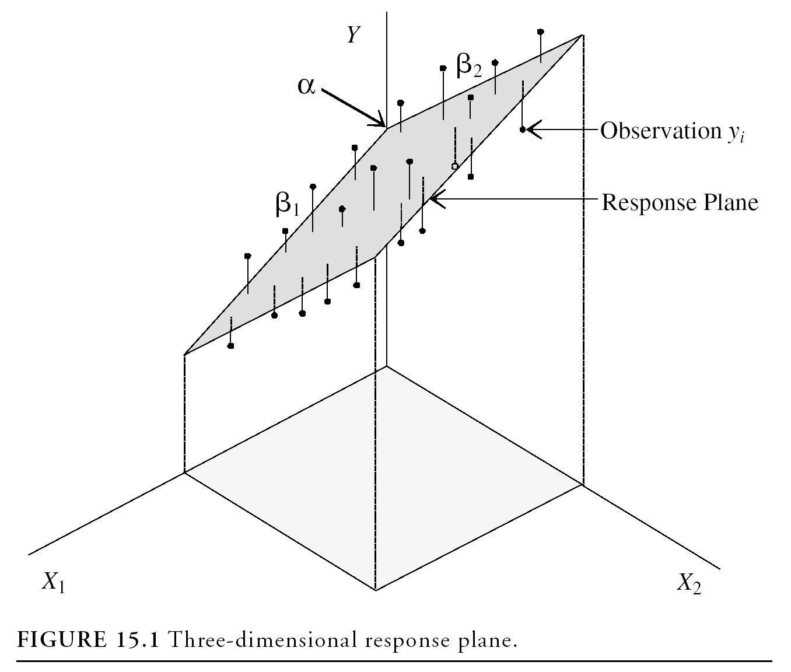
Regression Modeling
A simple regression model (one independent variable) fits a regression line in 2-dimensional space
A multiple regression model with two explanatory variables fits a regression plane in 3-dimensional space

Slide 6
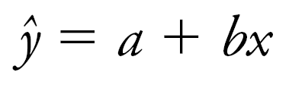
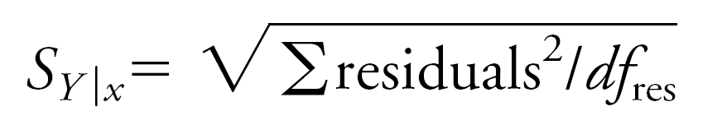
Simple Regression Model
Regression coefficients are estimated by minimizing ∑residuals² (i.e., sum of the squared residuals) to derive this model:
The standard error of the regression (s_{Y|x}) is based on the squared residuals:

Slide 7
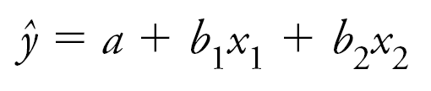
Multiple Regression Model
Again, estimates for the multiple slope coefficients are derived by minimizing ∑residuals² to derive this multiple regression model:
Again, the standard error of the regression is based on the ∑residuals²:

Slide 8
Multiple Regression Model
Intercept α predicts where the regression plane crosses the Y axis
Slope for variable X₁ (β₁) predicts the change in Y per unit X₁ holding X₂ constant
The slope for variable X₂ (β₂) predicts the change in Y per unit X₂ holding X₁ constant

Slide 9

Multiple Regression Model
A multiple regression model with k independent variables fits a regression “surface” in k + 1 dimensional space (cannot be visualized)

Slide 10
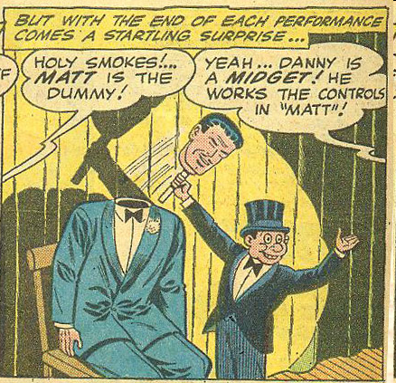
15.3 Categorical Explanatory Variables in Regression Models
Categorical independent variables can be incorporated into a regression model by converting them into 0/1 (“dummy”) variables
For binary variables, code dummies “0” for “no” and 1 for “yes”

Slide 11
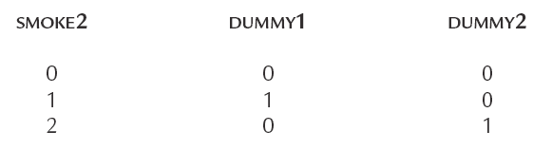
Dummy Variables, More than two levels
For categorical variables with k categories, use k–1 dummy variables
SMOKE2 has three levels, initially coded
0 = non-smoker
1 = former smoker
2 = current smoker
Use k – 1 = 3 – 1 = 2 dummy variables to code this information like this:

Slide 12
Illustrative Example
Childhood respiratory health survey.
Binary explanatory variable (SMOKE) is coded 0 for non-smoker and 1 for smoker
Response variable Forced Expiratory Volume (FEV) is measured in liters/second
The mean FEV in nonsmokers is 2.566
The mean FEV in smokers is 3.277

Slide 13
Example, cont.
Regress FEV on SMOKE least squares regression line:
ŷ = 2.566 + 0.711X
Intercept (2.566) = the mean FEV of group 0
Slope = the mean difference in FEV
= 3.277 − 2.566 = 0.711
t_{stat} = 6.464 with 652 df, P ≈ 0.000 (same as equal variance t test)
The 95% CI for slope β is 0.495 to 0.927 (same as the 95% CI for μ₁ − μ₀)

Slide 14
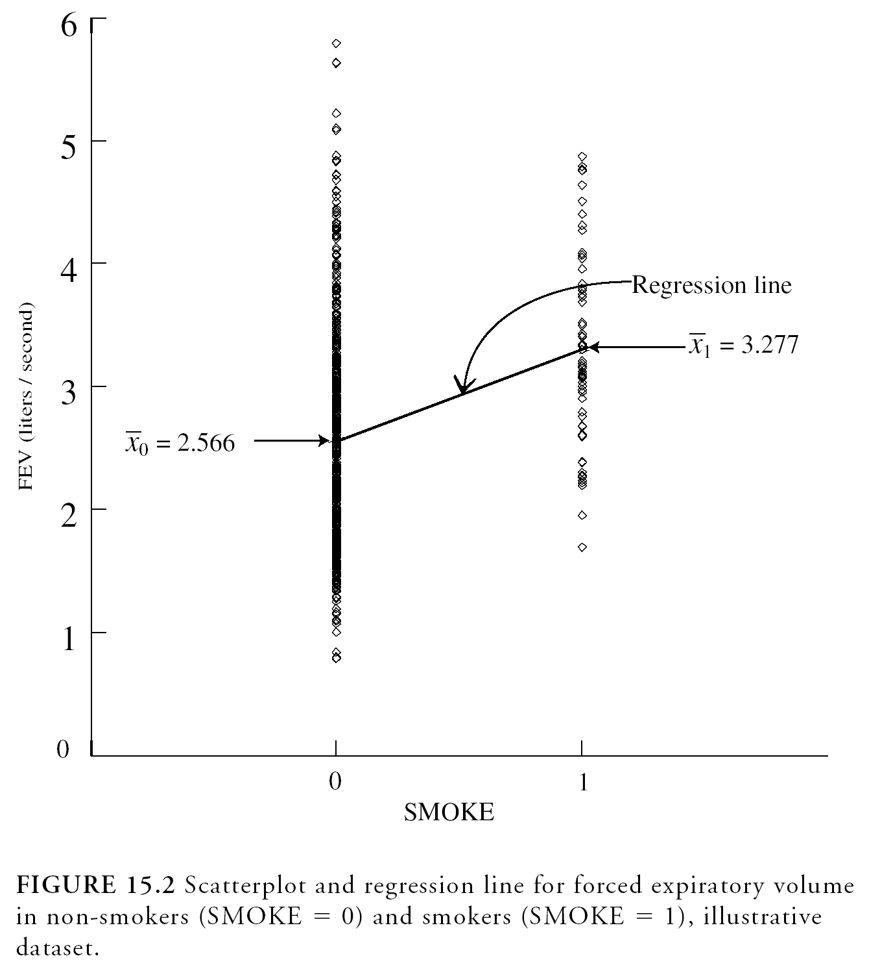
Dummy Variable SMOKE
b = 3.277 – 2.566 = 0.711
Regression line passes through group means

Slide 15
Smoking increases FEV?
Children who smoked had higher mean FEV
How can this be true given what we know about the deleterious respiratory effects of smoking?
ANS: Smokers were older than the nonsmokers
AGE confounded the relationship between SMOKE and FEV
A multiple regression model can be used to adjust for AGE in this situation

Slide 16
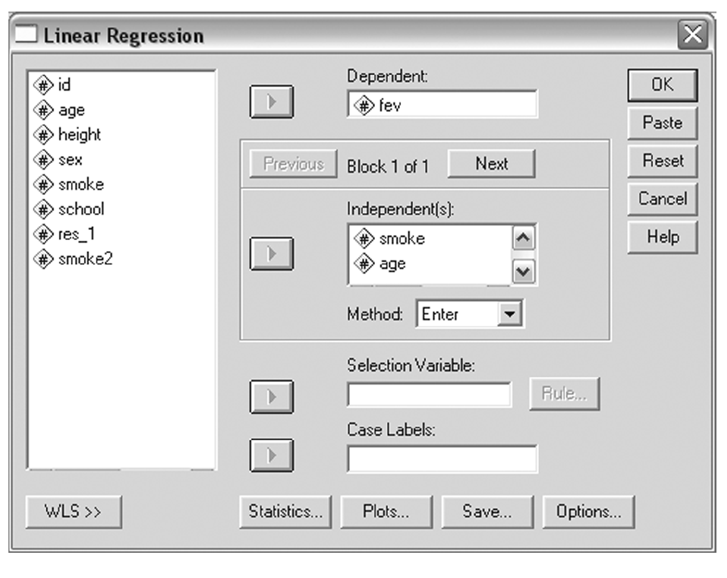
15.4 Multiple Regression Coefficients
Rely on software to calculate multiple regression statistics

Slide 17
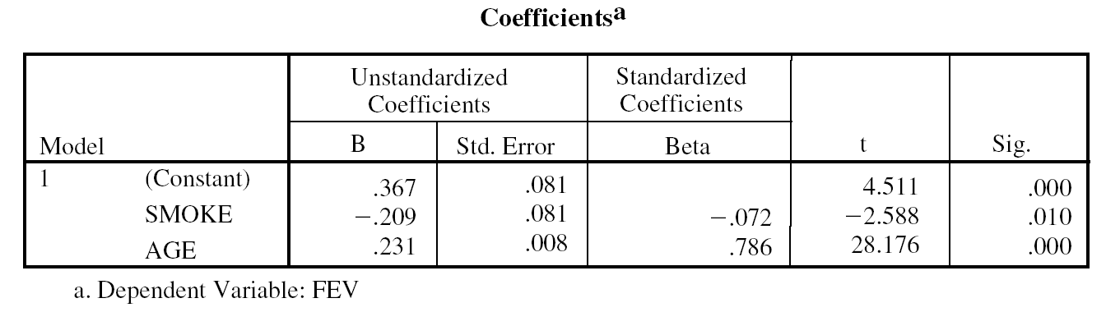
Example
SPSS output for our example:
Intercept a
Slope b₁
Slope b₂
The multiple regression model is:
FEV = 0.367 + −.209(SMOKE) + .231(AGE)

Slide 18
Multiple Regression Coefficients, cont.
The slope coefficient associated for SMOKE is −.206, suggesting that smokers have .206 less FEV on average compared to non-smokers (after adjusting for age)
The slope coefficient for AGE is .231, suggesting that each year of age in associated with an increase of .231 FEV units on average (after adjusting for SMOKE)

Slide 19
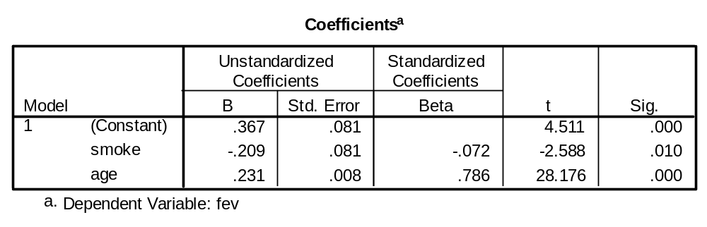
Inference About the Coefficients
Inferential statistics are calculated for each regression coefficient. For example, in testing
H₀: β₁ = 0 (SMOKE coefficient controlling for AGE)
t_{stat} = −2.588 and P = 0.010
df = n – k – 1 = 654 – 2 – 1 = 651

Slide 20
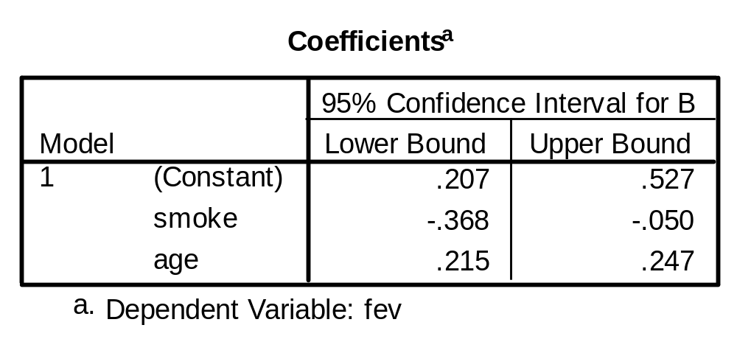
Inference About the Coefficients
The 95% confidence interval for this slope of SMOKE controlling for AGE is −0.368 to − 0.050.

Slide 21
15.5 ANOVA for Multiple Regression
pp. 343 – 346
(not covered in some courses)

Slide 22
15.6 Examining Regression Conditions
Conditions for multiple regression mirror those of simple regression
  Linearity
  Independence
  Normality
  Equal variance
These are evaluated by analyzing the pattern of the residuals

Slide 23
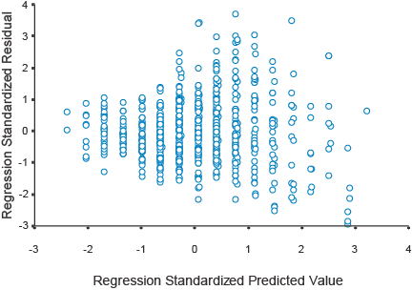
Residual Plot
Figure: Standardized residuals plotted against standardized predicted values for the illustration (FEV regressed on AGE and SMOKE)
Same number of points above and below horizontal of 0 ⇒ no major departures from linearity
Higher variability at higher values of Y ⇒ unequal variance (biologically reasonable)

Slide 24
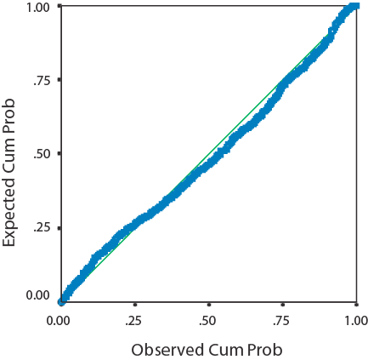
Examining Conditions
Normal Q-Q plot of standardized residuals
Fairly straight diagonal suggests no major departures from Normality

